Slide 1
Hackers 2 Hackers Conference 2017 October 21-22 - Sao Paulo/Brazil Some challenges and trends in cryptography, and its implementation Shay Gueron University of Haifa, Israel Amazon Web Services (AWS)

Slide 2
Agenda
Part I: Authenticated encryption:
The rise of AES-GCM
Brittleness: nonce repetition
Nonce misuse resistance
AES-GCM-SIV: and efficient instantiation
Part II: Don’t encrypt without authentication
Is DRAM really vulnerable?
Does encryption save the day? (no ☹)
Agora não falarei muito.
Direto ao ponto

Slide 3
Agenda
Part I: Authenticated encryption:
The rise of AES-GCM
Brittleness: nonce repetition
Nonce misuse resistance
AES-GCM-SIV: and efficient instantiation
Part II: Don’t encrypt without authentication
Is DRAM really vulnerable?
Does encryption save the day? (no ☹)

Slide 4
AES-GCM in a nutshell
Efficient Authenticated Encryption is important
e.g., in client-server communications (TLS)
By now: AES-GCM has already become the de-facto mode of operation for authenticated encryption
Part of (current) TLS 1.2
Planned to be one of the only two supported AEAD in TLS 1.3
Preferred server & client choice on the leading servers / browsers
(when the CPU is detected to have AES-NI & PCLMULQDQ instructions)
Advantages:
Security proof
Excellent performance on modern CPU’s with AES-NI & PCLMULQDQ

Slide 5
How did AES-GCM become attractive?
Up to 2009: dominating ciphers: AES-CBC / RC4 + HMAC SHA1
~90% of the traffic. AES-GCM practically non-existent
RC4 + HMAC SHA-1 ~9.5 C/B
AES + HMAC SHA-1 ~23 C/B
AES-GCM ~22 C/B
No performance advantage to AES-GCM – no motivation to migrate
Intel’s new instructions changed the situation
AES-NI for encryption and PCLMULQDQ (64-bit polynomial multiplication)
Continuous software/algorithmic optimizations for implementing AES-GCM
Improved AES-NI / PCLMULQDQ performance across CPU generations
So, where are we today?

Slide 6
AES-GCM across Intel CPU generations (2016)
(2015) AES-GCM at the cost of CTR!
Westmere, Sandy bridge, Haswell, Broadwell, Skylake are Intel Architecture Codenames.
Codenames Haswell: 4th Generation Intel® Core Processor
Codenames Broadwell: 5th Generation Intel® Core Processor
Codenames Skylake: 6th Generation Intel® Core Processor

Slide 7
AES-GCM ubiquity
2012: TLS 1.2 announced (including AES-GCM as an option)
Slow proliferation: only a few % of the TLS traffic use TLS1.2
Majority of TLS: TLS1.0 (broken) and TLS1.1
Dominating encryption: AES-CBC / RC4 + HMAC SHA1 (~90% of the traffic)
2015 (Dec): Distribution of encrypted traffic
AES-GCM: 52% AES-CBC: 30% CHACHA-POLY: 18%
CHACHA-POLY: cipher for mobile phones having 32-bit “weak” CPU’s
2016 (Nov): Distribution of encrypted traffic
AES-GCM: 64.1% AES-CBC: 20.0% CHACHA-POLY: 15.7%
Trend continues: AES-GCM dominates
CBC is now 20%, down from 30%.
CHACHA-POLY slight decrease (modern smartphones start having HW AES too)

Slide 8
What happens when things go wrong?
Security bounds
Privacy: CTR has good security bounds – the counter blocks consist of a nonce (IV), and security is preserved as long as the nonce doesn’t repeat
CTR is broken if a nonce repeats
Integrity: IV/nonce reuse
AES-GCM – completely broken
But why should an IV Repeat?

Slide 9
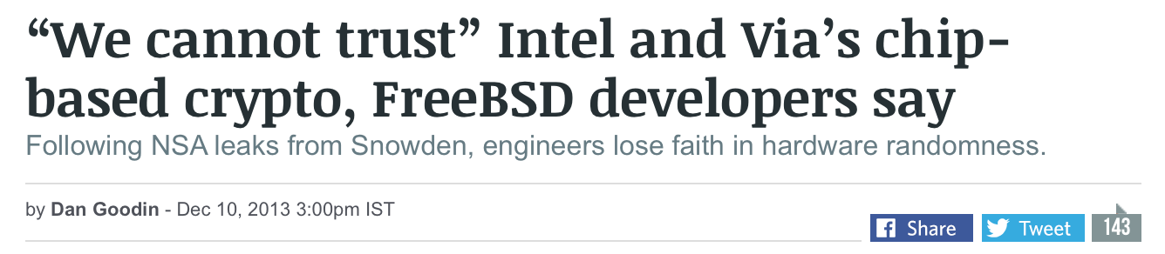
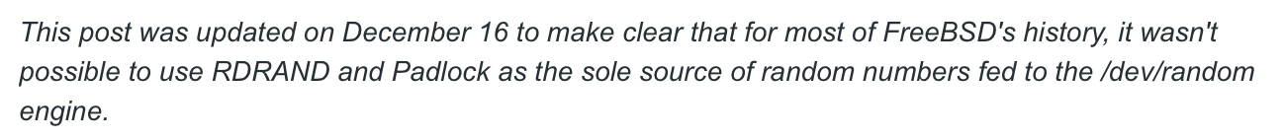
Why Should an IV Repeat? A brief history of “bad randomness”
Randomness is much harder than it should be
Intel has RDRAND and RDSEED on all new processors
Not used inside Linux /dev/random (at the time)

Slide 10
Bad Randomness
In 2008, a bug in Debian Linux was found
In 2006, code that was crucial for RNG reseeding was commented out
PlayStation 3
In 2010, the ECDSA private key used by Sony to sign software for PlayStation 3 was recovered because Sony failed to generate a new random nonce for each signature

Slide 11
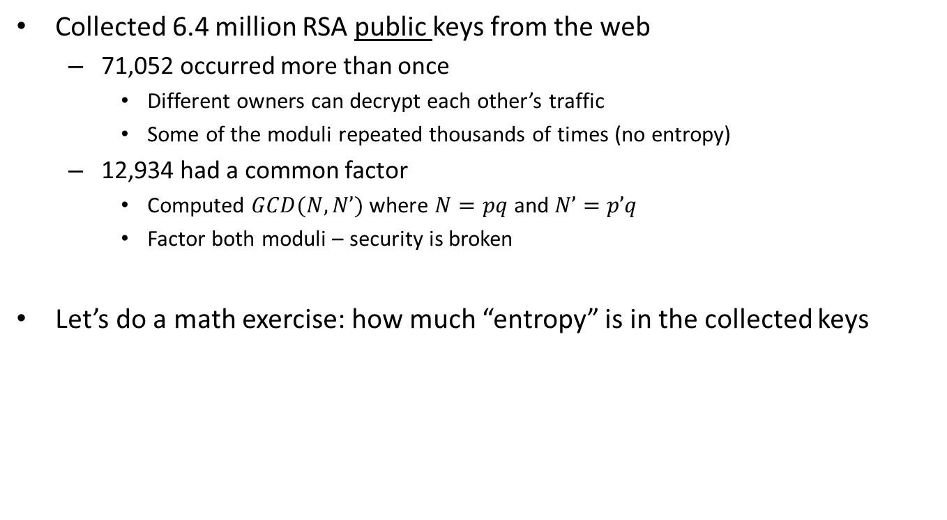
RSA Keys – Lenstra et al. 2012
Collected 6.4 million RSA public keys from the web
71,052 occurred more than once
Different owners can decrypt each other’s traffic
Some of the moduli repeated thousands of times (no entropy)
12,934 had a common factor
Computed $GCD(N,N’)$where $N=pq$ and $N’=p’q$
Factor both moduli – security is broken
Let’s do a math exercise: how much “entropy” is in the collected keys

Slide 12
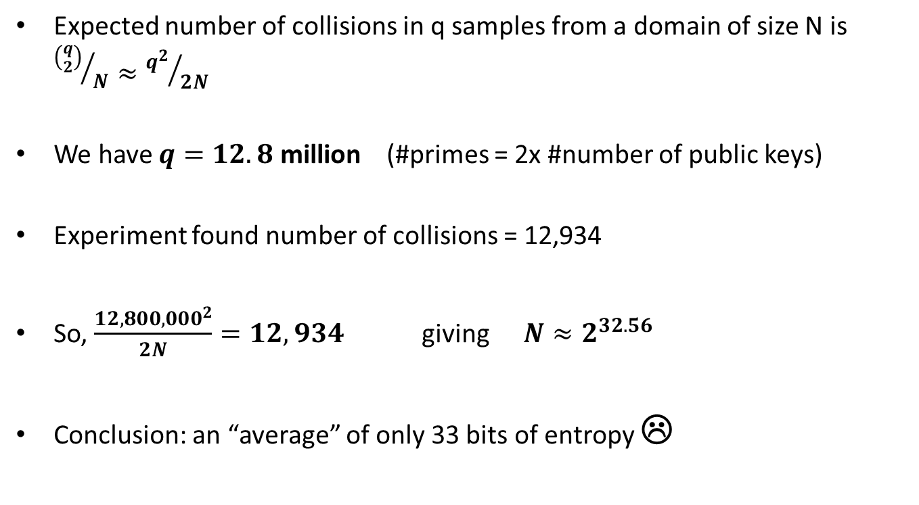
Entropy Estimation via RSA Keys
Expected number of collisions in q samples from a domain of size N is ${\left({q \atop 2}\right)}/N≈{q^{2}}/{2N}$
We have $q=12.8$ million (#primes = 2x #number of public keys)
Experiment found number of collisions = 12,934
So, $\frac{12,800,000^{2}}{2N}=12,934$ giving $N≈2^{32.56}$
Conclusion: an “average” of only 33 bits of entropy ☹

Slide 13
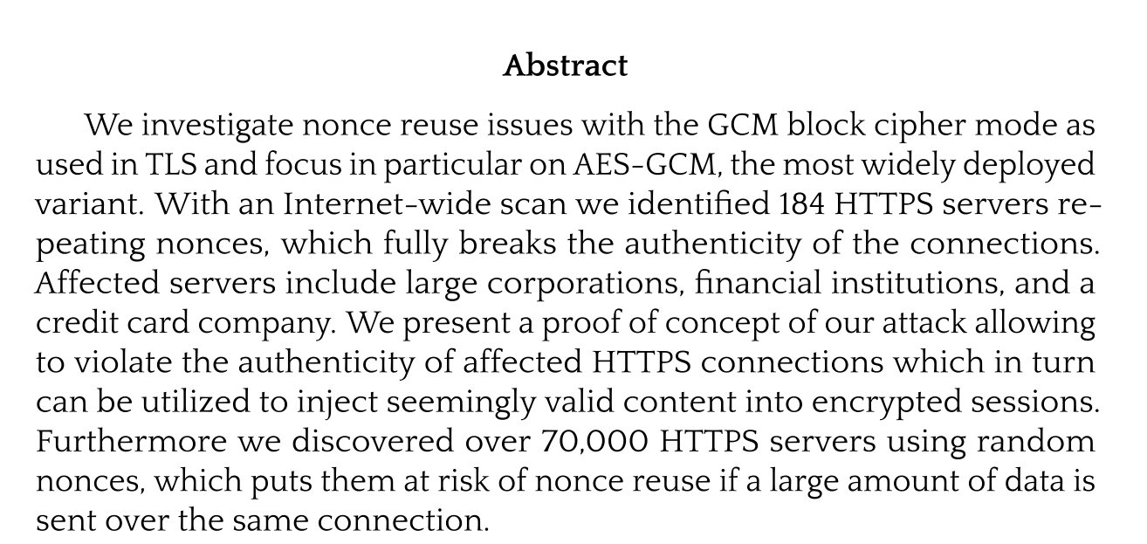
And as we were discussing history
Böck, Zauner, Devlin, Somorovsky, Jovanovic (May 2016)
Nonce-Disrespecting Adversaries: Practical Forgery Attacks on GCM in TLS

Slide 14
Randomness can repeat and does repeat, What should we do?
Our goal: an Authenticated Encryption scheme that
Is nonce-misuse resistant (security)
Enjoys the performance benefits of AES-GCM (performance)
Uses only small changes over existing standard (easy deployment)
Can re-use software (and hardware) components (efficiency)
Can we really have the cake and eat it?
YES!
Let’s make AES-GCM great again

Slide 15
Nonce Misuse Resistance [Rogaway-Shrimpton]
Denote nonce by N
Desired security property
If N is same and message is same – the result is the same ciphertext
This is inherent
Otherwise – full security (authenticated encryption):
Even if N is the same and the message is not
Even if N is different and the message is the same
This cannot be achieved for online encryption
If two long messages differ only in the last bit, when same N is used, must have same prefix when online

Slide 16
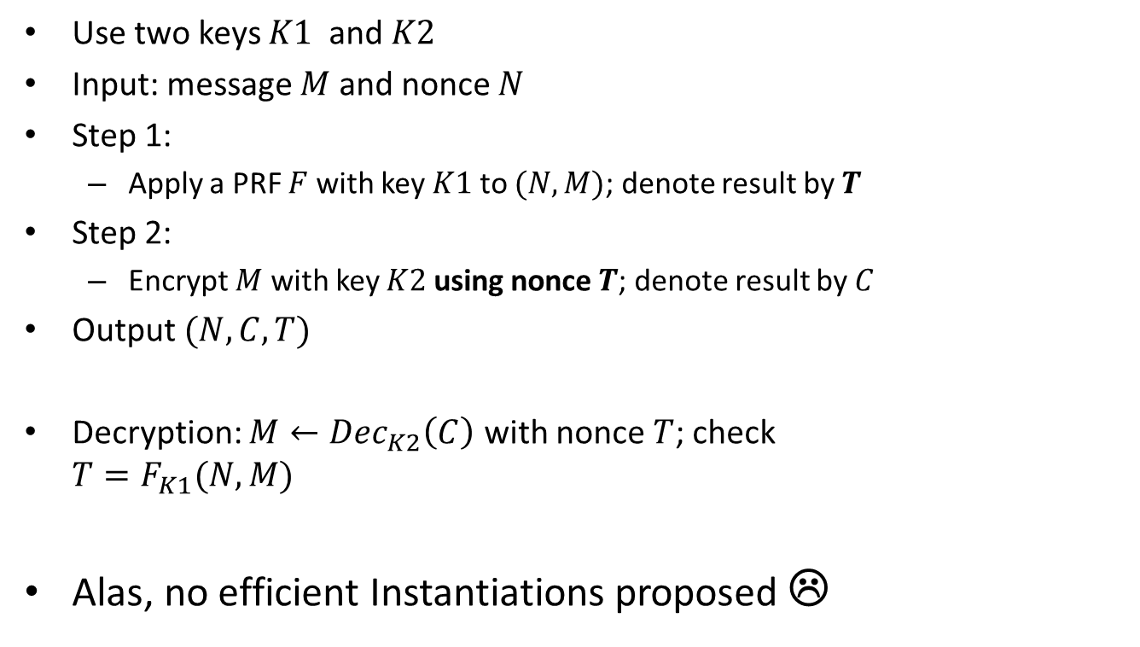
Abstract SIV Encryption [Rogaway-Shrimpton]
Use two keys $K1$ and $K2$
Input: message $M$ and nonce $N$
Step 1:
Apply a PRF $F$ with key $K1$ to $(N,M)$; denote result by $T$
Step 2:
Encrypt $M$ with key $K2$ using nonce $T$; denote result by $C$
Output $(N,C,T)$
Decryption: $M←Dec_{K2}\left(C\right)$ with nonce $T$; check $T=F_{K1}(N,M)$
Alas, no efficient Instantiations proposed ☹
Synthetic IV

Slide 17
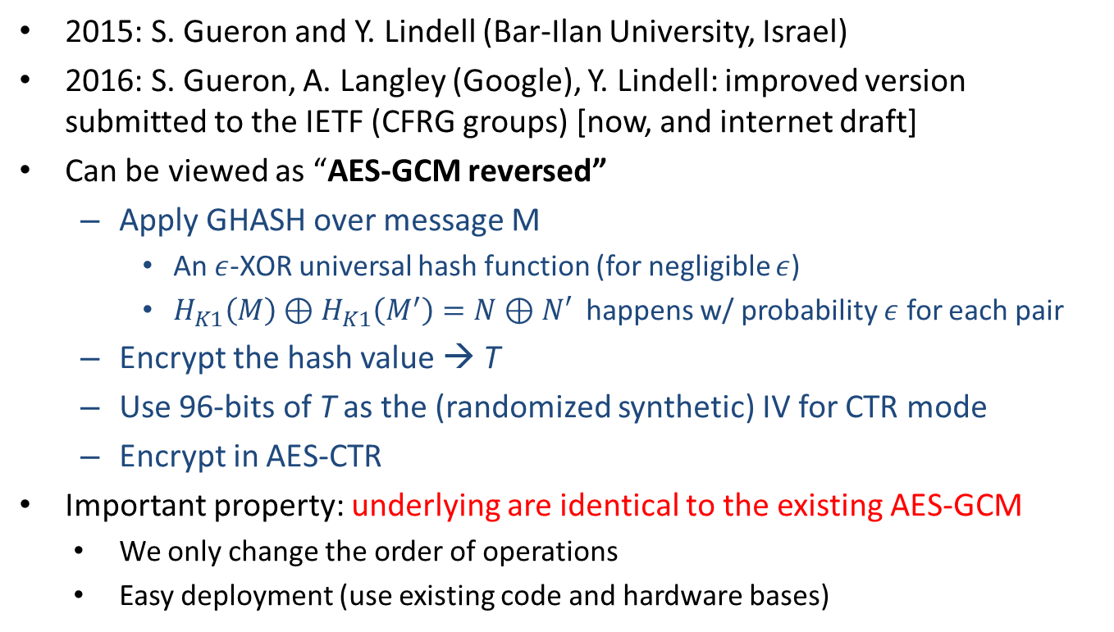
The AES-GCM-SIV Instantiation
2015: S. Gueron and Y. Lindell (Bar-Ilan University, Israel)
2016: S. Gueron, A. Langley (Google), Y. Lindell: improved version submitted to the IETF (CFRG groups) [now, and internet draft]
Can be viewed as “AES-GCM reversed”
Apply GHASH over message M
An $ε$-XOR universal hash function (for negligible $ε$)
$H_{K1}\left(M\right)⊕H_{K1}\left(M^{′}\right)=N⊕N′$ happens w/ probability $ε$ for each pair
Encrypt the hash value → T
Use 96-bits of T as the (randomized synthetic) IV for CTR mode
Encrypt in AES-CTR
Important property: underlying are identical to the existing AES-GCM
We only change the order of operations
Easy deployment (use existing code and hardware bases)

Slide 18



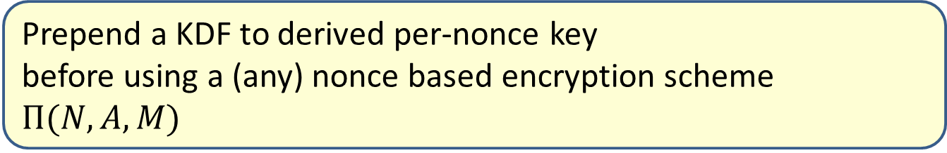



Derive Key Mode to extend the lifetime of a key
Prepend a KDF to derived per-nonce key
before using a (any) nonce based encryption scheme $Π(N, A, M)$
$$N, A, M$$
$$N$$
$$K(N)$$
$$KDF(K)$$
$$Π(N, A, M)$$
$$C, T$$
AES-GCM-SIV is a Derive Key mode
Can encrypt up to 2⁶⁴ (not too long) message
with the same master key

Slide 19
AES-GCM-SIV Performance – Highlights
Nonce misuse resistant AEAD in less than 1 C/B
AES-GCM-SIV over 8KB message

Slide 20
Summary
Full nonce misuse-resistant authenticated encryption at an extremely low cost (almost AES-GCM)
Full proof of security and full implementation
Easily deployable:
Utilizes existing hardware
Utilize existing code and software (AES-GCM implementations)
Unpatented
Detailed specifications, reference code and Open Source optimized code implementation
Soon to be integrated into BoringSSL (Google’s version of OpenSSL)
We hope to see it adopted, to increase security of implementations

Slide 21
Agenda
Lição importante
Não encripte sem autenticação
Nunca!
Part I: Authenticated encryption:
The rise of AES-GCM
Brittleness: nonce repetition
Nonce misuse resistance
AES-GCM-SIV: Let’s make AES-GCM great again
Part II: Don’t encrypt without authentication
Is DRAM really vulnerable?
Does encryption save the day? (no ☹)

Slide 22
Demonstrating recent works (2016) with multiple collaborators
Blinded random corruption attacks
HOST 2016 (IEEE International Symposium on Hardware Oriented Security and Trust)
H2HC Conference 2016 Keynote
Is your memory protected? Attacks on encrypted memory and constructions for memory protection
Fault Attacks on Encrypted General Purpose Compute Platforms
Announced as a poster at CHES 2016
Shay Gueron, Jan Nordholz * , Jean-Pierre Seifert * , Julian Vetter *
* TU Berlin, Germany

Slide 23
Background
Old news
Adversaries with physical access to attacked platform – are a concern
Mobile devices (stolen/lost)
Cloud computing (un-trusted environments)
Read/write memory capabilities as an attack tool have been demonstrated:
Using different physical interfaces
Thunderbolt, Firewire, PCIe, PCMCIA and new USB standards
Consequences of DRAM modification capabilities:
Active attack on memory are possible
Attacker can change code / data from any value to any chosen value
But this is too easy… right?
What if memory is encrypted?
Underlying attack assumption on the threat model:
The attacker has physical means to modify DRAM

Slide 24
Transparent memory encryption
Proposed technologies against active attacks were
Limiting the attacker’s physical ability to read/write memory
E.g., blocking DMA access in some scenarios
Memory encryption
Memory encryption using “transparent encryption” mode:
Simpler, cheaper, faster than “encryption + authentication”
Seems to be effective for limiting active dynamic attacks
Although the physical memory modification capabilities remain available
Attacker has limited control on the result of active attacks
Underlying attack assumption: attacker has physical means to modify DRAM

Slide 25
1 image, 1000 words?
Security perimeter is the CPU package boundary
Data and code unencrypted inside CPU package
Data and code outside CPU package is encrypted
External memory reads and bus snoops see only encrypted data
CPU Package
^{CPU Package}
Cores
System Memory
Cache
^{Jco3lks937weu0cwejpoi9987v80we}
^{AMEX: 3234-134584-26864}
Taken from Intel’s SGX materials

Slide 26
Blinded Random Block Corruption
Under memory encryption, the attacker has limited capabilities
Blinded Random Block Corruption (BRBC) attack
(Blinded) The attacker does not know the plaintext memory values he can read from the (encrypted) memory.
(Random (Block) Corruption) The attacker cannot control nor predict the plaintext value that would infiltrate the system when a modified (encrypted) DRAM value is read in and decrypted.
Expect randomly corrupted data of to be the result of the decryption
Question: does memory encryption (limiting the active dynamic attacker capabilities to BRBC only) provide a “good enough” mitigation in practice?
Underlying attack assumption: attacker has physical means to modify DRAM

Slide 27
Becoming “root” on a locked system with a BRBC attack
global var1…varn
global preauth_flag
global preauth_related
code_logic() {
if (preauth_enabled) {
call_preauth_mechanism() -> sets preauth_flag if successful
}
repeat_auth:
if (preauth_flag) goto auth_ok;
authentication_logic();
auth_ok:
return;
}
BRBC Attack to the preauth_flag

Slide 28
Becoming “root” on a locked system with a BRBC attack
global var1…varn
global preauth_flag
global preauth_related
code_logic() {
if (preauth_enabled) {
call_preauth_mechanism() -> sets preauth_flag if successful
}
repeat_auth:
if (preauth_flag) goto auth_ok;
authentication_logic(); -> THIS NEVER GETS EXECUTED!
auth_ok:
return;
}

Slide 29
TOCTOU (Time-of-use/Time-of-check) Race Condition
This was caused by our arbitrary memory write (the BRBC)
The corrupted values adjacent to the preauth_flag were not used at this moment (thus the block corruption is not a problem)
The check for the preauth_flag only checks for not 0 (thus we don’t need to control the exact value)
Remember that limitation for the attack: conditionals comparing with 0

Slide 30
The cloud scenario
Hypervisor has management interfaces
VM Introspection capabilities exist for legitimate reasons
Inspect inside guest VMs, to auto-configure network elements, to distribute resources
The same capabilities can be “abused” by a malicious administrator (even in the presence of a trusted hypervisor)
Memory encryption of guest machines remove the ability of administrator to snoop into the VM’s memory
A different key per-VM is necessary, to avoid replay attacks with known plaintext/ciphertext in another VM fully controlled by the attacker
CPU control through introspection is similar to JTAG control (flow changes can be performed without a BRBC attack)
BRBC attack might be more reliable in scenarios where multiple connections are made to the machine (like in a server scenario)

Slide 31
Memory encryption with VM-unique keys The threat model
Cloud service provider hosts multiple customers’ VM’s
But users do not necessarily trust this remote environment:
An operator at the cloud provider’s facility can use the hypervisor’s capabilities to read any VM’s memory
Assumption: the hypervisor is trusted (else – game over)
Measured hypervisor
Memory encryption:
Each guest VM encrypts its memory space with a unique (per-VM) key
Hypervisor capabilities remain, but:
Since memory is encrypted with a VM-unique key, the user’s data privacy is protected

Slide 32
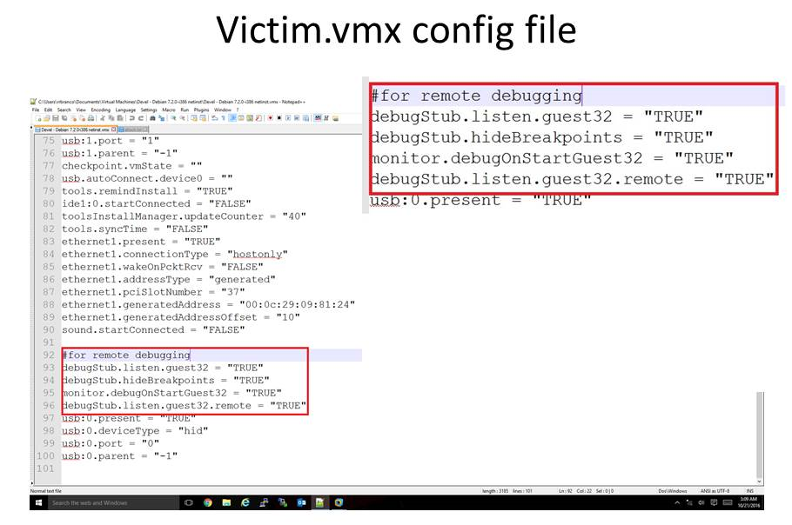

Did you know?
A per-VM config file allows the admin to enable “debug”.
It is an important feature offered by VMware (and most Hypervisors)
But this feature
grants us
the ability to write to memory

Slide 33
The old video

Slide 34
So, what is new for H2HC 2017?
Agora veja isto
The main limitation of our previous approach was that we needed conditionals comparing with not 0 values that were benefitial to an attacker
While such conditionals are frequent, some might argue that they can be easily eliminated by software (automatically even, with compiler changes)
But we still believed that the attacker premisses are way too powerful to be so limited, and we were right!

Slide 35
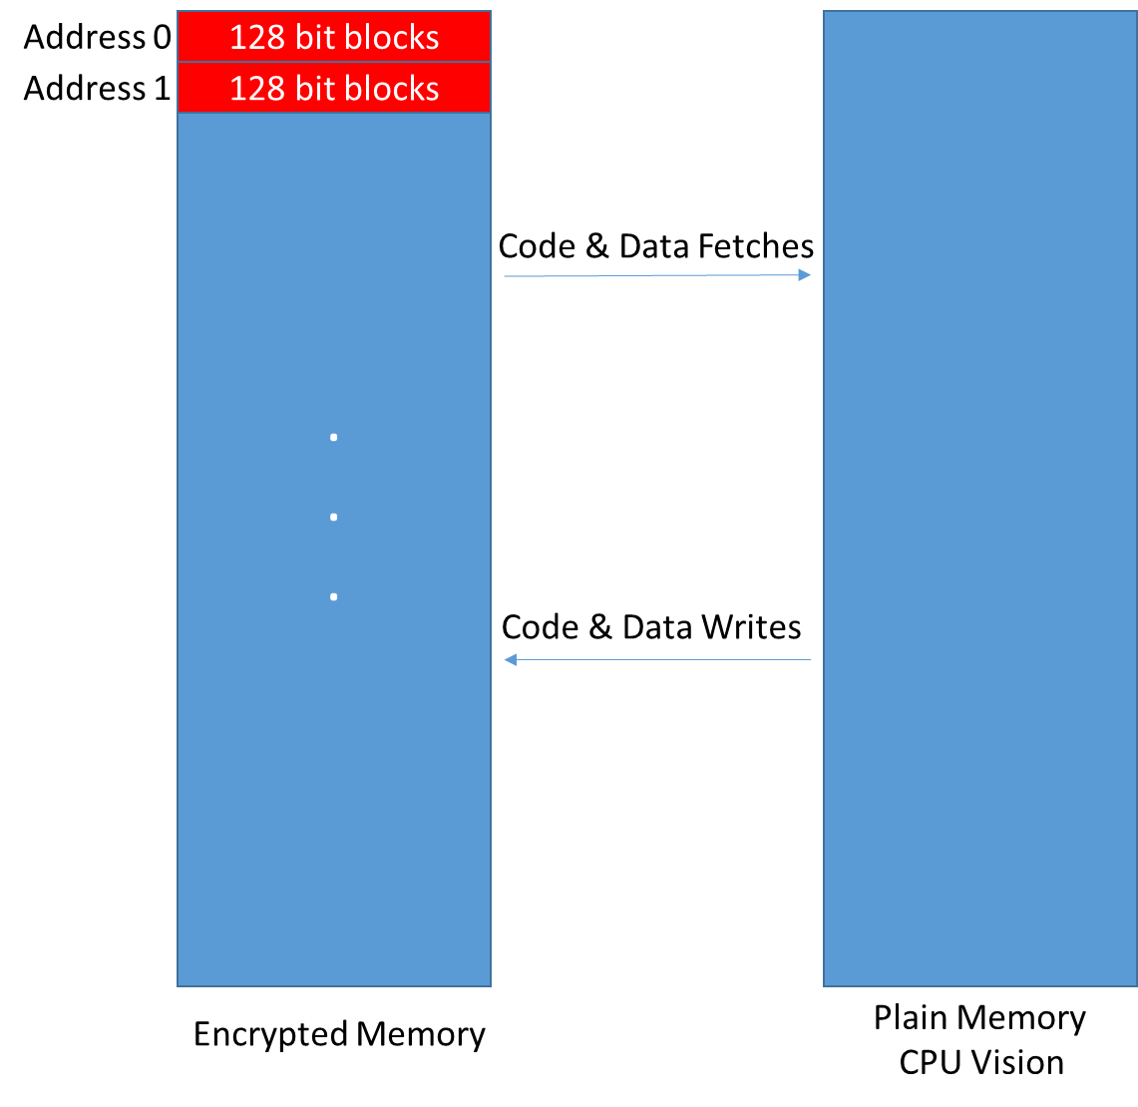
Not only “zero conditional” anymore
We are showing addresses in the encrypted memory as block locations, to facilitate the Discussion.

Slide 36
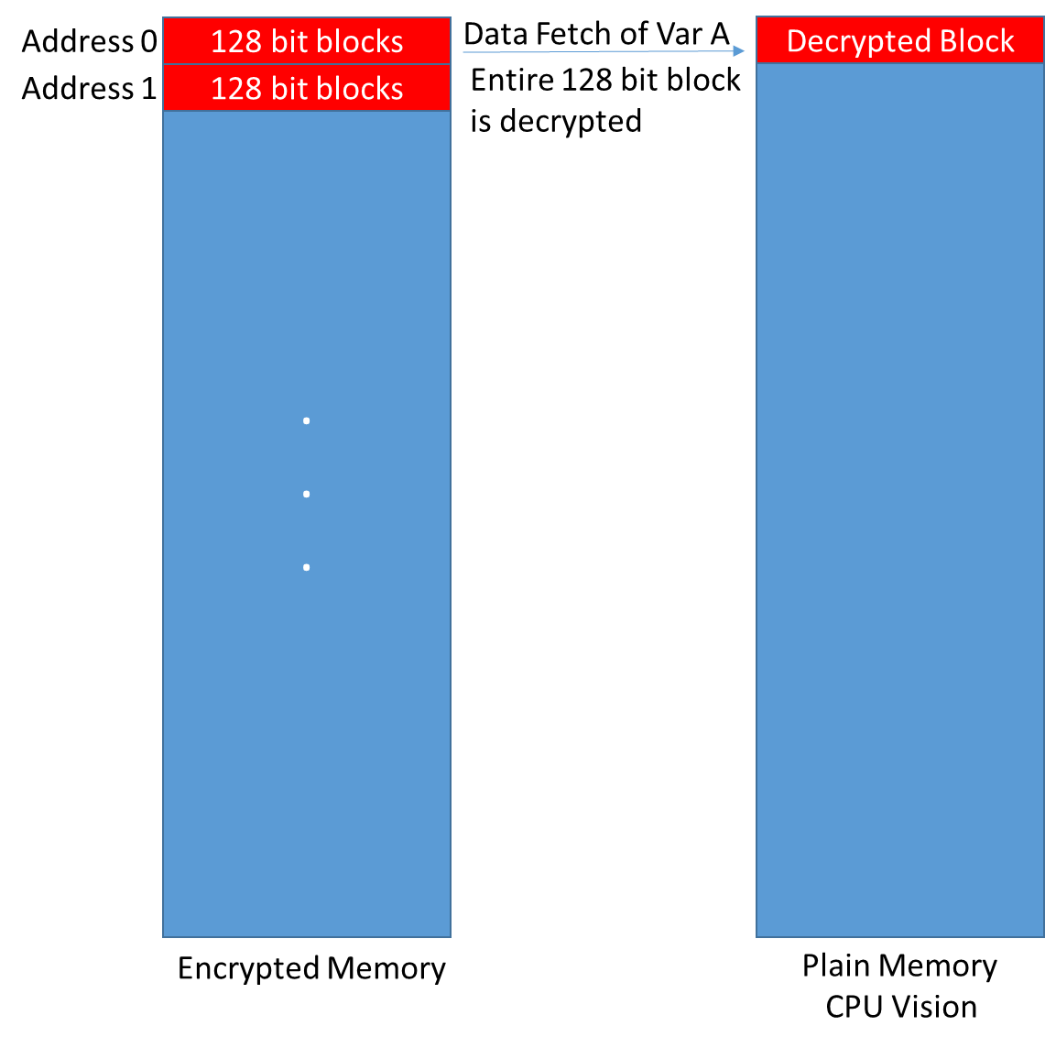

Block corruption independently randomly corrupt each element on the block
Showing addresses as block
locations, to facilitate the Discussion.
Var A:
For example, an unsigned char, an 8 bits type
Var B:
For example, an unsigned short, 16 bits type
Var C:
For example, an unsigned int, 32 bits type
Decrypted Block
Corrupting var A, also corrupts Var B and C
(bits corrupted randomly/independently as a property of the block cipher)

Slide 37
Introducing: Feasible Brute-force-based BRBC
If we find a way to brute-force a block that has this characteristics:
Many different data elements, with different sizes
One of those elements being of interest, and small enough to be fully brute-forced (like a 32 bit integer)
And for which we are able to tell if we somehow have a value we want
In which the other elements, if changed, do not affect our interests as an attacker
And for which any value would not affect the system stability (meaning: we can repeat the corruption as many times as we want)
Then we are able to:
Have a fully controlled memory overwrite! (we just need to brute-force the element of interest til it randomly has the value of our interest!)

Slide 38
Can we make a pie with so many ingredients? *
Linux Kernel manages processes using a data structure named task_struct
Such struct has lots of elements necessary to store the process information, such as memory areas, opened files, privileges and so on
For privileges, it uses a pointer to another data structure, which is the credentials... Having a look at it, we have something quite interesting

Slide 39

Sounded like impossible? A bit on the Linux Kernel...
Following the task_struct of a process (to find our target), we see there is a process credentials entry, which is a structure that has many elements, of interest we have:
kuid_t uid; /* real UID of the task */
kgid_t gid; /* real GID of the task */
kuid_t suid; /* saved UID of the task */
kgid_t sgid; /* saved GID of the task */
kuid_t euid; /* effective UID of the task */
kgid_t egid; /* effective GID of the task */
kuid_t fsuid; /* UID for VFS ops */
kgid_t fsgid; /* GID for VFS ops */
Notice that kuid_t and kgid_t are typedef’s to __kernel_uid32_t and __kernel_gid32_t, which in turn:
typedef unsigned int __kernel_uid32_t;
typedef unsigned int __kernel_gid32_t;

Slide 40
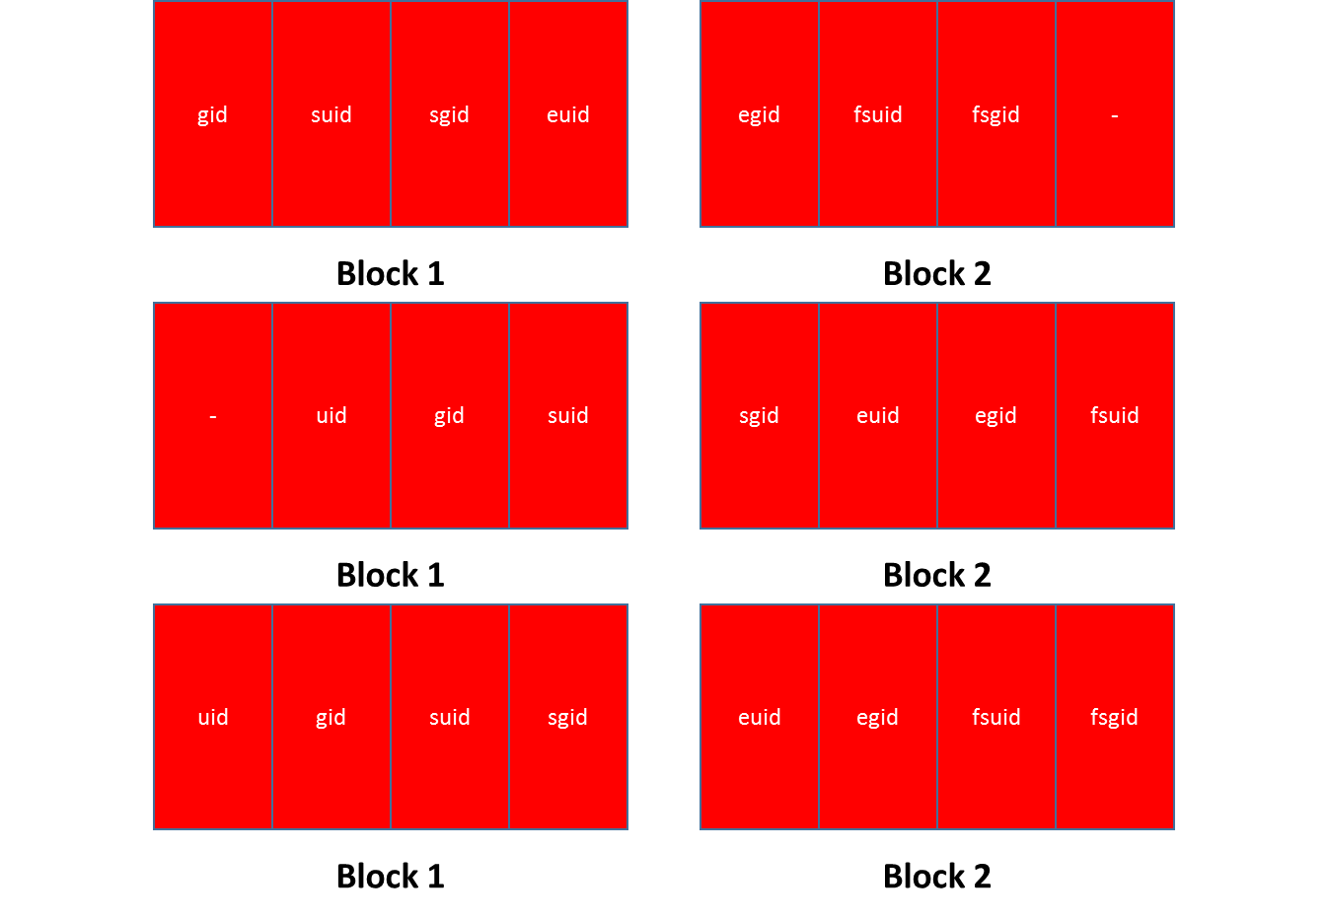
Is alignment inside the target block an issue? No, since the adjacent elements do not matter for the attack
Option 1
euid is last element
of a block
Affects: gid,
suid, sgid
(everything before it)
Option 2
euid is middle element of a block
Affects: sgid, egid, fsuid
(max 2 before and two after it)
Option 3
euid is first element of a block
Affects: egid, fsuid, fsgid
(everything after it)

Slide 41
Do we have a winner candidate?
Premisse | Does it satisfy?
Many different data elements, with different sizes | Yes
One of those elements being of interest, and small enough to be fully brute-forced (like a 32 bit integer) | Yes (euid is our target)
And for which we are able to tell if we somehow have a value we want | Yes (our target process has elevated privileges)
In which the other elements, if changed, do not affect our interests as an attacker | Yes (we can change other elements if needed with the privileges)
And for which any value would not affect the system stability (meaning: we can repeat the corruption as many times as we want) | Yes

Slide 42
What about limitations?
We need to be able to locate such a data structure in memory (we are blind to the memory contents)
There are a lot of challenges to being able to do that (and system pressure might affect the ability of doing it)
For now, our PoC requires a process running on the target (with no privileges)
We elevate that process’ privilege
The requirement for such a process is exactly to avoid the limitation (given we have a process we control, we use such a process to spawn multiple child process and create a predictible memory layout and pattern that we can identify – that is how we locate the correct structure in memory)
We studying other possibilities (like for server-side process that anyhow spawn child process, and others)

Slide 43
Summary and conclusions
Agora veja isto
Encryption-only by itself is not necessarily a “good enough” defense-in-depth mechanism against arbitrary memory write primitive
A short video
Lição importante
Não encripte sem autenticação
Nunca!
Thank you for your attention

Slide 44
Summary and conclusions
Muito obrigado pelo seu tempo
Encryption-only by itself is not necessarily a “good enough” defense-in-depth mechanism against arbitrary memory write primitive
A short video
Thank you for your time

Slide 45
Summary and conclusions
Aventura Cultural!
Encryption-only by itself is not necessarily a “good enough” defense-in-depth mechanism against arbitrary memory write primitive
A short video
Thank you for your time

